Slide 1
AGE CALCULATION USING C

Slide 2
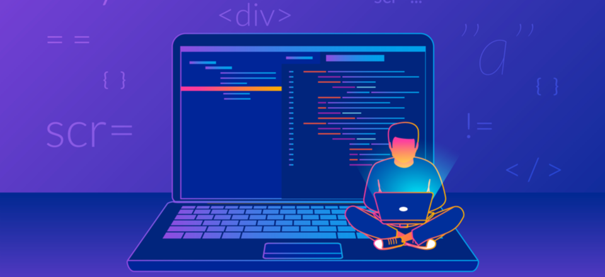
*GROUP MEMBERS*
SANATH KUMAR {GROUP LEADER} [52]
S.YASHWANT RAJ REDDY [40]
P.SAKETH [37]
MAHINDAR NAIK[39]
NIHANTH [57]
PREETHAM [24]
GAIKWAD[60]
SRIKANTH[53]

Slide 3
TABLE OF CONTENTS.
01
02
03
04
05
06
Description about the program
Alogorithm
Flow Chart
Code input
Output
conclusion.

Slide 4
# Description about the program.
01

Slide 5
As the title says main theme of this project is "Calculating the Age". The user can calculate the age of anything. Age calculator is an online tool with which you can find out your age using your date of birth and the current date. The tool helps to find out the difference in time between two dates. The results are also not affected by the time zone of a person since the tool just tells you the difference in time. The age calculator is based on the common age system, therefore it can be used by everyone.

Slide 6
Alternatively, you can enter a date of your choice in the Current Age or Age as of field to know your age at that particular point in time. Additionally, this calculator can be used to determine the age of things such as a historical monument or a vintage/collectable item.
GROWING OLD IS A CASE OF MIND OVER MATTER, IF YOU DON’T MIND, IT DOESN’T MATTER

Slide 7
# ALGORITHM
02

Slide 8
Step 1 : Start
Step 2 : Declare d1,m1,y1,d2,m2,y2,r1,r2,r3,n=1
Step 3 : Take the values of date, month, year from user and
store them as d1,m1,y1
Step 4 : Take the values of current date, month, year form user
as d2,m2,y2
Step 5 : if d1, d2 are equal and m1, m2 are
also equal the print happy birthday.
Step 6 : if d1 or d2>31 or d1 or d2<1 or m1 or m2>12 or m1 or m2<1
or y1 or y2<0 display error otherwise go to next step
Step 7 : r3=y2-y1 if d2>=d1 then r1 becomes d2-d1
if not then m2=m2-1; d2=d2+30 and r1=d2-d1
Step 8 : if m2>=m1 then r2 becomes m2-m1
else r3 decreases by 1 and m2=m2+30 also r2 becomes m2-m1
Step 9 : Display the age
Step 10: Ask the user to do one more calculation and take n value
Step 11: while n==1 repeat the program from the beginning
Step 12: Stop

Slide 9
# FLOWCHART
03

Slide 10
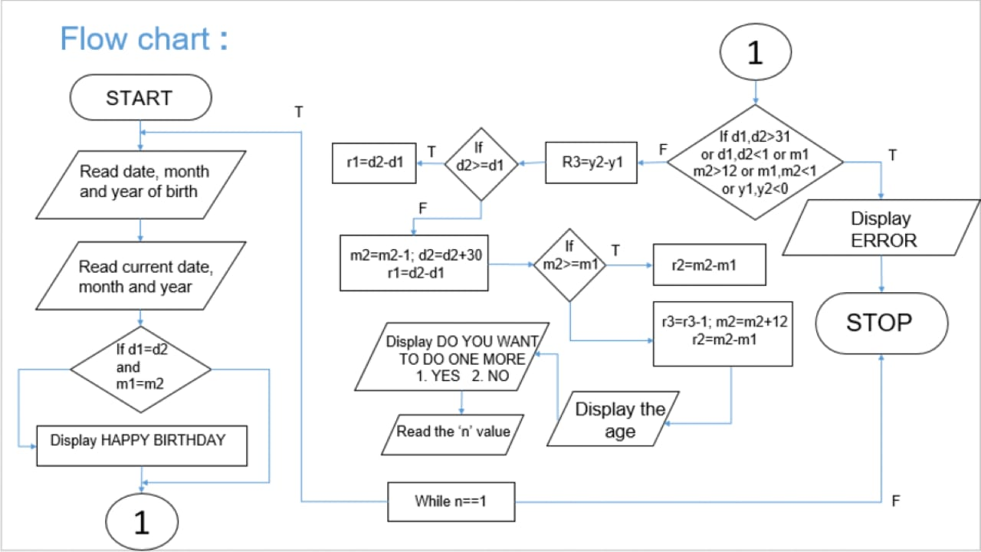
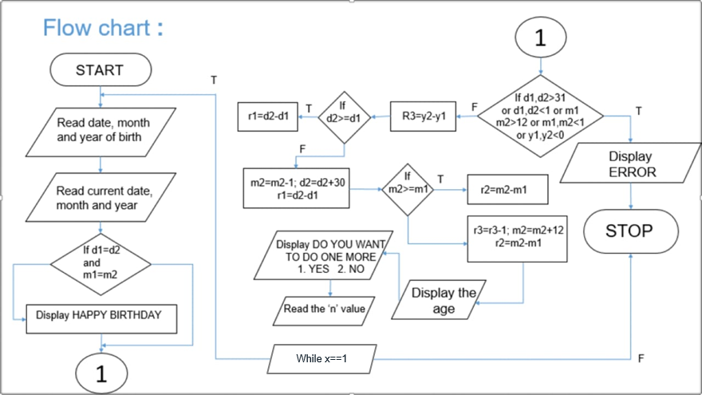

Slide 11
# CODE INPUT
04

Slide 12
#include <stdio.h>
#include <unistd.h>
int main()
{
int d1,m1,y1,d2,m2,y2,r1,r2,r3,n=1;
while (n==1)
{
printf("*************************************************************************************************\n");
printf(" AGE CALCULATION USING C \n");
printf("*************************************************************************************************\n");
printf("Enter date of birth in DD format : ");
scanf("%d",&d1);

Slide 13
sleep(1);
printf("Enter month of birth in MM format : ");
scanf("%d",&m1);
sleep(1);
printf("Enter year of birth in YYYY format : ");
scanf("%d",&y1);
sleep(1);
printf("Enter today's date in DD format : ");
scanf("%d",&d2);
sleep(1);
printf("Enter present month in MM format : ");
scanf("%d",&m2);
sleep(1);
printf("Enter present year in YYYY format ");

Slide 14
scanf("%d",&y2);
sleep(1);
if((d1>31 || d1<1) && (d2>31 || d2<1) && (m1>12 || m1<1) && (m2>12 || m2<1) && (y2<0) && (y1<0) )
{
printf("ERROR........\n");
sleep(1);
printf("PLEASE CHECK THE DATE YOU ENTERED");
}
else
{
r3=y2-y1;
if(d2>d1)
{

Slide 15
r1=d2-d1;
}
else
{
m2=m2-1;
d2=d2+30;
r1=d2-d1;
}
if(m2>=m1)
{
r2=m2-m1;
}
else
{
r3=r3-1;

Slide 16
m2=m2+12;
r2=m2-m1;
}
printf("HEY YOUR ARE %d Years %d Months %d Days OLD\n",r3,r2,r1);
sleep(3);
printf("DO YOU WANT TO DO ONE MORE...\n");
sleep(1);
printf("1. YES\n");
sleep(1);
printf("2. NO\n");
scanf("%d",&n);

Slide 17
if (n>1)
{
printf("THANK YOU\n");
sleep(1);
printf("HAVE A NICE DAY......");
}
}
}
return 0;
}

Slide 18
# Code Output.
05

Slide 19
EXAMPLE:-
*************************************************************************************************
AGE CALCULATION USING C
*************************************************************************************************
Enter date of birth in DD format : 03
Enter month of birth in MM format : 02
Enter year of birth in YYYY format : 2005
Enter today's date in DD format : 14
Enter present month in MM format : 02
Enter present year in YYYY format 2023
HEY YOUR ARE 18 Years 0 Months 11 Days OLD
DO YOU WANT TO DO ONE MORE...
1. YES
2. NO

Slide 20
THANK YOU!

